Slide 1
Stanly County Comprehensive Transportation Plan (CTP) Overview
Temilope Animashaun, Roger Castillo
March 5, 2024

Slide 2
Today’s Agenda
What is a Comprehensive Transportation Plan? (Recap)
Steering Committee Roles
CTP Vision and Goals
Draft Goals and Objectives Survey Walkthrough
Identification of Study Roads
Next Steps

Slide 3
What is a CTP?
Anson County CTP
Comprehensive Transportation Plan
Long-range, multi-modal transportation plan
25 to 30 year planning period
Vision plan
Developed cooperatively among local stakeholders, Rural Planning Organization (RPO), and NCDOT
Incorporates Land Use plans, community & statewide goals

Slide 4
Where does the CTP fit into the “Big Picture”?
Anson County CTP
Long-Range Planning CTP
Determining the Need
North Carolina Prioritization Process
Project given a score for funding consideration
Program Development
Funding the Projects
Project Planning
Minimizing the Impacts
Project Design
Design & Right-of-Way (ROW)
Construction, Maintenance, Operations
Building & Maintaining the Road

Slide 5
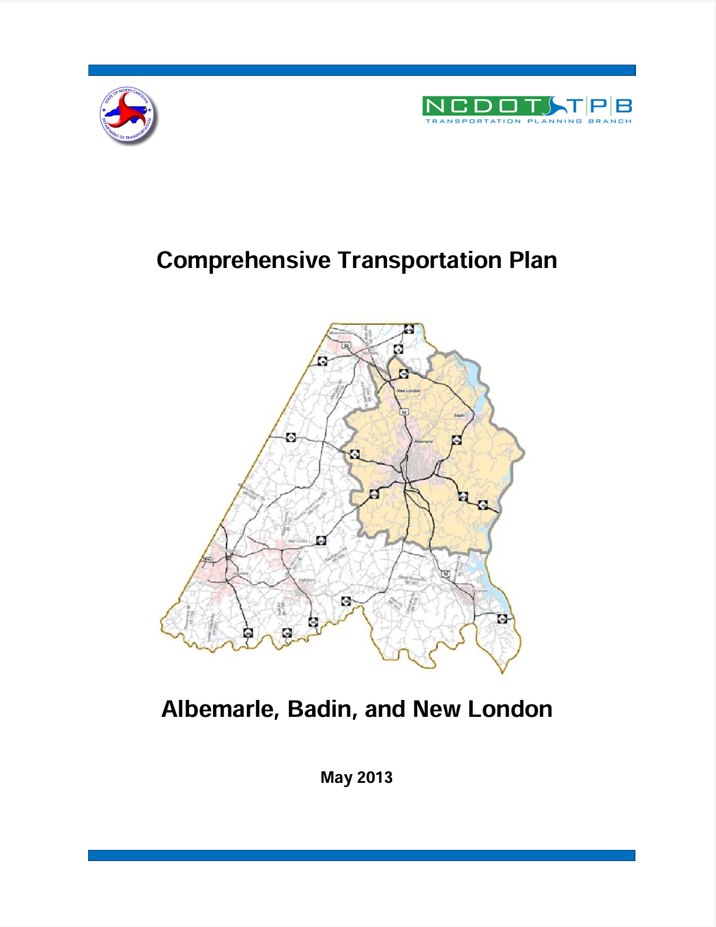
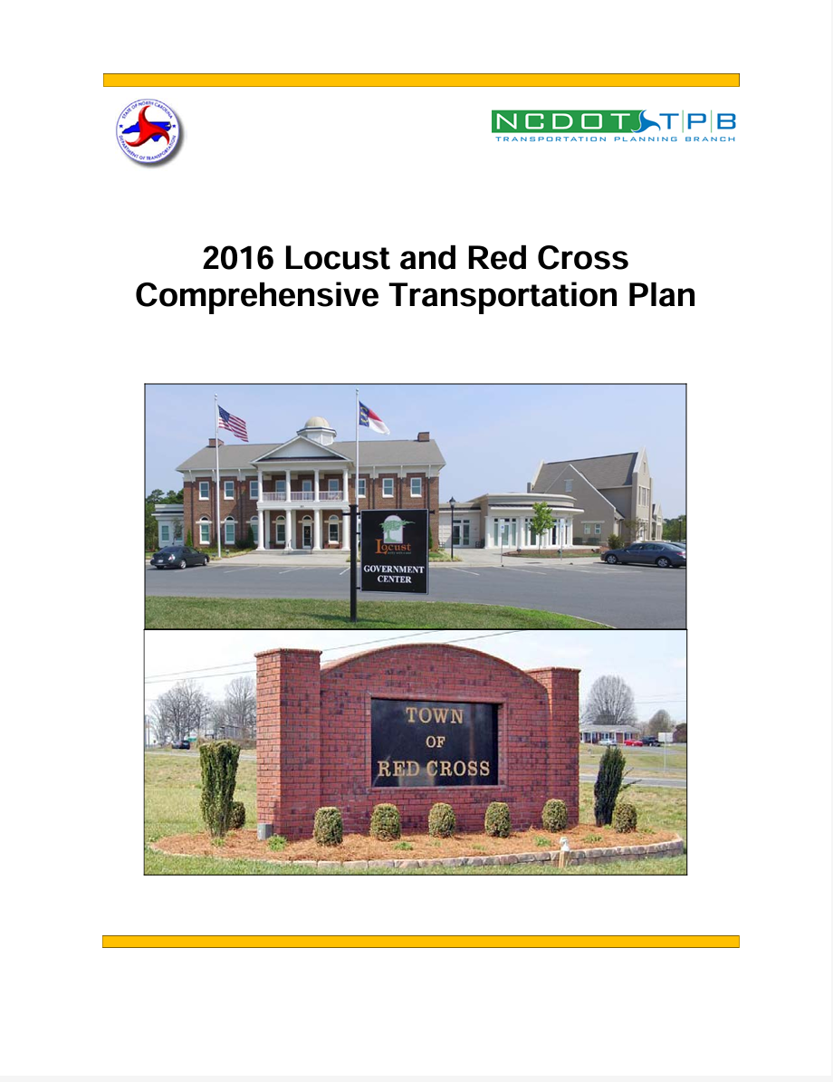
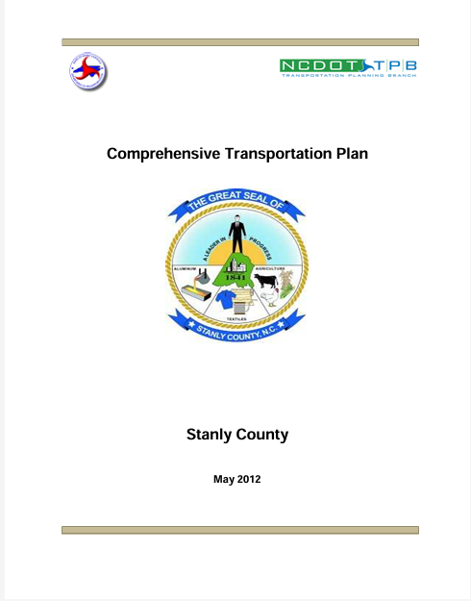
Stanly County
Anson County CTP

Slide 6
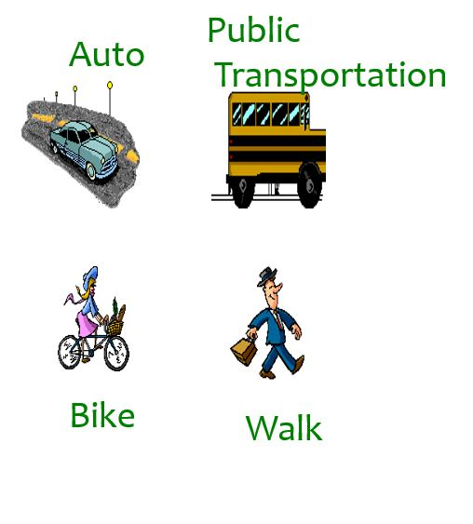
What is in a CTP?
Anson County CTP
Multimodal Maps
Highway
Public Transportation and Rail
Bicycle/Pedestrian
Current and Future Conditions
Lanes
Right-of-Way (ROW)
Volume and Capacity
Recommendations
Existing
Proposed

Slide 7
What are the Benefits of a CTP?
Anson County CTP
A transportation plan that is coordinated with the local growth plan
Results guide the RPO to submit projects to NCDOT for project consideration.
Common, long-range vision for facilities among local governments, RPO, and NCDOT
Notes:
It is coordinated effort
As mentioned before; recommendations help guide the RPO to submit projects for consideration
It is a common long range vision among various parties

Slide 8
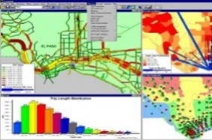
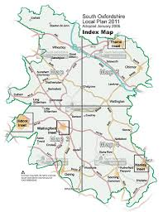
For All modes: Highway, Public Transportation, Bicycle & Pedestrian, Rail & Freight
Develop Vision
System Assessment
Analyze Alternatives
Develop
Draft Plan
Adopt
Plan
Latest Planning Assumptions
Community Understanding
Validate
Vision
Public Involvement

Slide 9
CTP Steering Committee
Anson County CTP
Members
NCDOT – Transportation Planning Division and Division 10
RPO – Rocky River RPO
Local Stakeholders – County, towns, business interests, multi-modal reps, environmental interests, Title VI, schools, elderly, etc.
The Public

Slide 10
CTP Steering Committee
Anson County CTP
Roles
Represent stakeholders in the county
Assist with public engagement
Sharing your unique perspective during the planning process
Review plan as it is developed
Informing others about the CTP
Assist with adoption and endorsement

Slide 11
Vision/Goals
Produce and maintain a Comprehensive Transportation Plan to preserve and promote the quality of life and economic vitality of Stanly County and all its municipalities. This will be accomplished by providing an accessible, integrated, efficient, safe, and environmentally responsible multi-modal transportation system.
Preserve, protect, and enhance the natural and human environment.
Improve the safety, connectivity, and mobility of the transportation system, for people and freight, for all modes of transportation in and through the region.
Maintain and enhance the quality and performance of the transportation system in Stanly County through efficient congestion management and operations techniques.
Promote and enhance connectivity and mobility throughout Stanly County and the surrounding region and metropolitan areas.
Improve the security of the transportation system in Stanly County for all modes and users.
Encourage preservation of scenic views and rural character.
Provide an adequate transportation network and infrastructure for the agricultural industry.

Slide 12
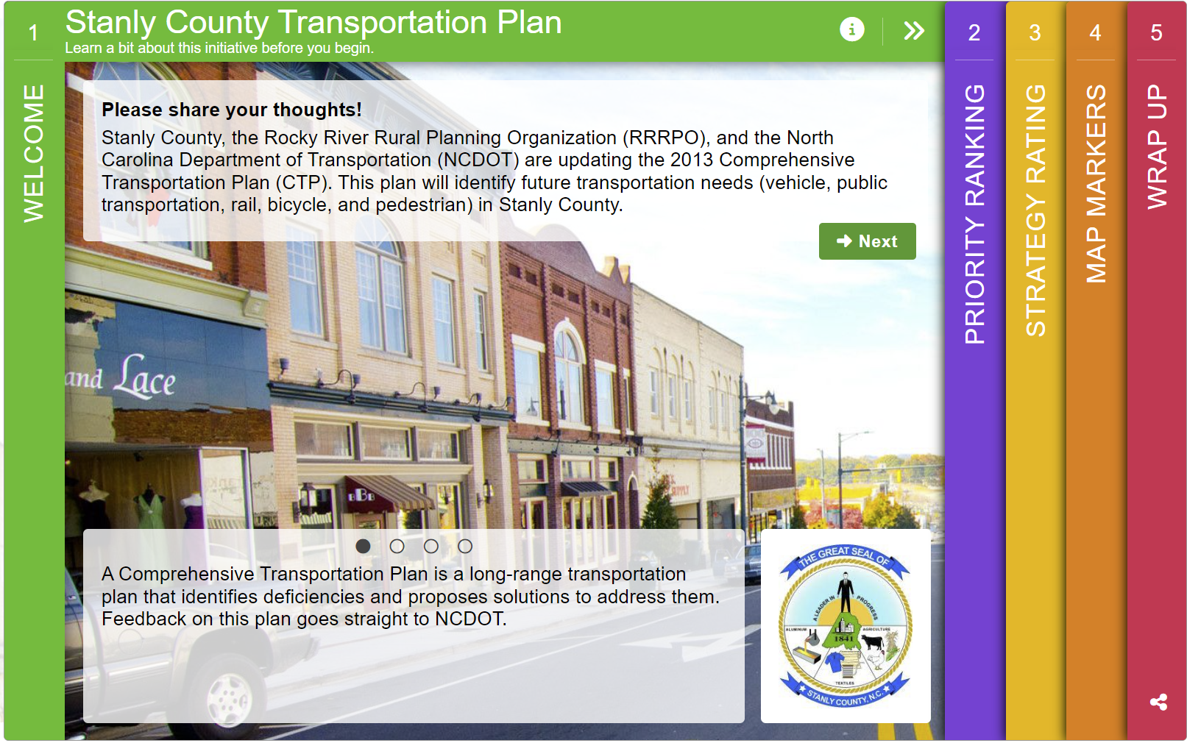
Goals and Objectives Survey
Things to consider:
Are there any specific questions we want to ask?
Any specific location we want public feedback on?
How do we want to distribute these?
Flyers
Methods of distribution
Locations
Stores
Draft Survey Demo Link:
https://demo.metroquestsurvey.com/en2z2f

Slide 13
Identification of Studied Roads
Study Roads are roads that we will be focusing on during analysis of the transportation network for the CTP study.
Study Roads typically contain the following:
Major Roadways (Interstate, US, and NC routes)
Highly Frequented Roads
Facilities that go through multiple municipalities
Important roadway connectors
Important intermodal connectors
Any other road the steering committee would like to be added to address transportation issues.

Slide 14
Contacts
Anson County CTP
NCDOT Transportation Planning Division (TPD)
Temilope Animashaun, tmanimashaun@ncdot.gov, (919)-707-0931 (Project Engineer)
Roger Castillo, ricastillo@ncdot.gov, (919) 707-0942 (Project Engineer)
Rocky River Rural Planning Organization (RPO)
Lee Snuggs, lsnuggs@rockyriverrpo.org, (704) 986-3871

Slide 15
QUESTIONS

